Slide 1


Employment Dynamics and Dividend Payouts: Analyzing the Interplay in Stock Market Performance
Breanna Mitchell, Lucas Ludwig, and Eric Martin

Slide 2
Project Description
The objective of this project is to analyze the relationship between employment dynamics and dividend payouts and their impact on the stock market performance of companies. The project will seek to answer the question of whether changes in employment dynamics, such as layoffs or hiring sprees, have a significant impact on the dividend payout decisions of companies, and whether such decisions subsequently affect the performance of their stock prices.
The project will use a mixed-methods approach, involving both quantitative and qualitative data analysis. The quantitative analysis will involve collecting and analyzing data on the employment dynamics, dividend payouts, and stock market performance of a sample of companies from a range of industries. The qualitative analysis will involve conducting interviews with industry experts to gain insights into the factors that influence companies' decisions on employment and dividend payouts.

Slide 3

Research Questions
1) How does a company's employment history (such as employee growth, turnover rate, and average tenure) correlate with its dividend payout patterns in the stock market over a specific time period?
2) Are companies more likely to decrease or increase their dividend payouts following a change in their employment dynamics?
3) To what extent do changes in dividend payouts of companies affect their stock market performance? Are companies with higher dividend payouts more likely to experience positive stock price movements, or is there no significant relationship between the two variables?
4) What are the key factors that influence companies' decisions on employment and dividend payouts?

Slide 4
Research Question 1
How does a company's employment history (such as employee growth, turnover rate, and average tenure) correlate with its dividend payout patterns in the stock market over a specific time period?
Employee growth and dividend payouts: If a company is experiencing rapid employee growth, it may indicate that the company is expanding and investing in its future. This could potentially lead to higher dividend payouts in the future if the company's growth translates to increased profits. However, if the employee growth is not sustainable or if it leads to increased costs without generating sufficient revenue, it may have a negative impact on dividend payouts.
Turnover rate and dividend payouts: A high turnover rate may be indicative of issues within the company, such as poor management or low job satisfaction. If these issues are not addressed, it may lead to decreased employee morale and lower productivity, which can negatively impact the company's financial performance and dividend payouts.
Average tenure and dividend payouts: A high average tenure may indicate that the company has a stable and experienced workforce. This could potentially lead to higher dividend payouts, as employees may be more committed to the company's long-term success. However, if the company is not investing in its future or adapting to changing market conditions, it may have a negative impact on dividend payouts in the long run.

Slide 5
Research Question 2
Are companies more likely to decrease or increase their dividend payouts following a change in their employment dynamics?
Increase in employment: If a company experiences an increase in employment due to strong demand for its products or services, it may be able to generate higher revenues and profits. This could potentially lead to increased dividend payouts if the company's management believes that it can sustain its growth trajectory and profitability in the long term.
Decrease in employment: If a company experiences a decrease in employment due to declining demand or cost-cutting measures, it may face challenges in maintaining its financial performance. In this case, the company may choose to reduce its dividend payouts to conserve cash and invest in growth opportunities or other priorities.
High employee turnover: If a company experiences high employee turnover due to poor management or low job satisfaction, it may have a negative impact on employee morale and productivity. This could potentially lead to lower financial performance and reduced dividend payouts if the company is unable to address the underlying issues.

Slide 6
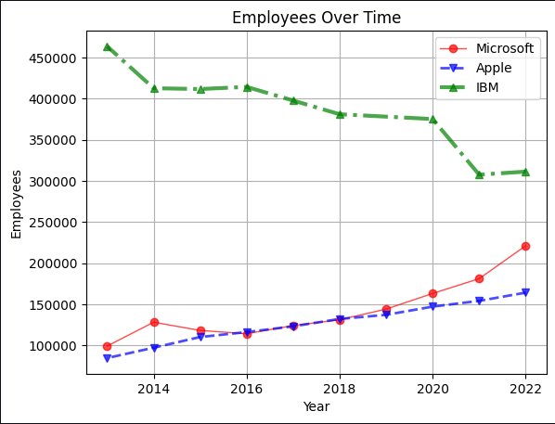
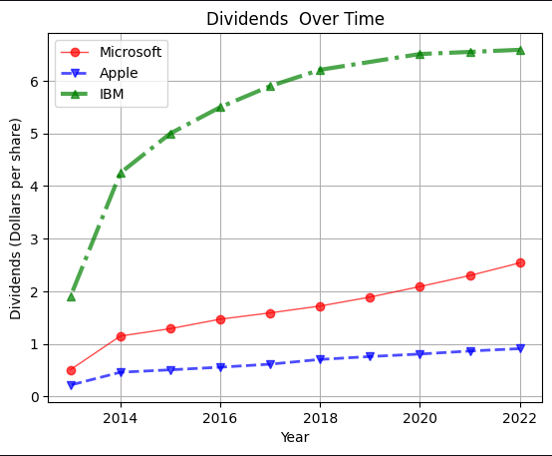
Research Question 1 + 2 Data

Slide 7
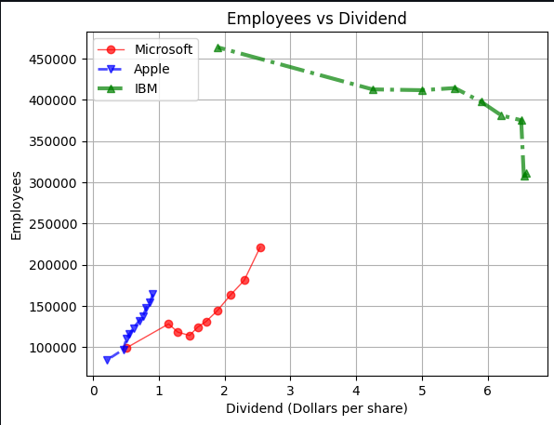
Research Question 1 Data

Slide 8
Research Question 3
To what extent do changes in dividend payouts of companies affect their stock market performance? Are companies with higher dividend payouts more likely to experience positive stock price movements, or is there no significant relationship between the two variables?
Companies that increase their dividend payouts are often viewed favorably by investors, as this can be a signal of strong financial performance and future growth potential. Therefore, companies with higher dividend payouts may be more likely to experience positive stock price movements in the short term.
The relationship between dividend payouts and stock price movements can also be influenced by other factors, such as interest rates, macroeconomic conditions, and industry trends. For example, if interest rates rise, dividend-paying stocks may become less attractive to investors, as they may be able to earn higher returns in other investments.
companies that prioritize dividend payouts may be viewed less favorably by investors if they are not investing in future growth opportunities or if their financial performance declines. In this case, the company's stock price may decrease despite its high dividend payouts

Slide 9
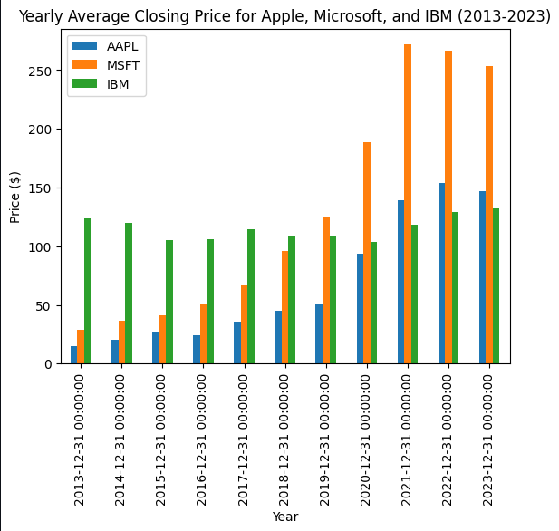
Research Question 3 Data

Slide 10
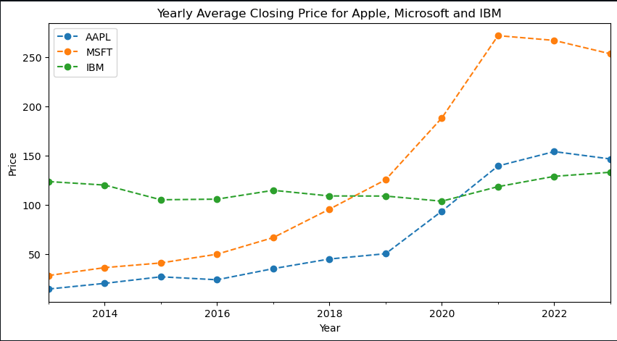
Research Question 3 Data

Slide 11
Research Question 4
What are the key factors that influence companies' decisions on employment and dividend payouts? What are the key factors that influence companies' decisions on employment and dividend payouts?
Financial Performance: A company's financial performance, including revenue growth, profit margins, and cash flow, can influence its decisions on employment and dividend payouts. If a company is performing well financially, it may be more likely to hire new employees and increase dividend payouts.
Market Conditions: Market conditions, such as competition, interest rates, and economic growth, can also play a role in a company's decisions on employment and dividends. If the market is highly competitive, a company may need to increase hiring to keep up with demand, while low interest rates may make it more attractive to distribute dividends to shareholders.
Shareholder Expectations: Shareholders often have expectations regarding a company's employment and dividend policies. If a company has a history of high dividend payouts, shareholders may expect the company to continue to prioritize dividends over hiring. Conversely, if a company is focused on growth and expansion, shareholders may expect the company to prioritize hiring new employees.
Regulatory Environment: Regulatory requirements and government policies can also impact a company's employment and dividend decisions. For example, if a company operates in an industry that is heavily regulated, it may need to prioritize hiring to comply with government requirements.
Corporate Strategy: Finally, a company's overall corporate strategy can influence its decisions on employment and dividends. If a company is focused on innovation and research and development, it may prioritize hiring skilled employees over distributing dividends. Conversely, if a company is focused on maximizing shareholder value, it may prioritize dividends over hiring new employees.
Overall, a company's decisions on employment and dividend payouts are influenced by a complex set of factors, and a careful balancing of these factors is necessary to ensure long-term success and sustainability

Slide 12





References
https://intrinio.com/
https://data.nasdaq.com/tools/api
https://www.alphavantage.co/academy/#academy-intro
SEC EDGAR Filings API (sec-api.io)

Slide 13

Thank You!
Group 5

